Slide 1
CONSTRUCT:
A HOUSE

Slide 2
Introduction
Name: Fred Bloggs
Position: Quantity Surveyor
Company: Company Name
Member Logo

Slide 3
My Role
What does a Quantity Surveyor do?
Keep an eye on the money!
Make sure the project finances are viable and the client can afford
Organising work into smaller chunks called packages and arranging other people to carry the work out
Monitoring progress of the project
Present data to enable payment to be made on work carried out
Deal with contractual & legal matters.
Member Logo

Slide 4
My Company
Have you heard of XXXXXX?
We are a ??????????? company.
We provide ?????????
We currently have sites in ??????
Projects we have been involved in are:
Member Logo

Slide 5
Why am I here today?
To help make you think about a career in construction by getting you to work in a small group, acting a construction company to building a house.
But this is no ordinary house.
This is a house that you would like to live in. Let your imagination go wild.
Member Logo

Slide 6
Lets talk: Houses
Can you
name different types of housing?
What makes them special?
What do you like about them?

Slide 7
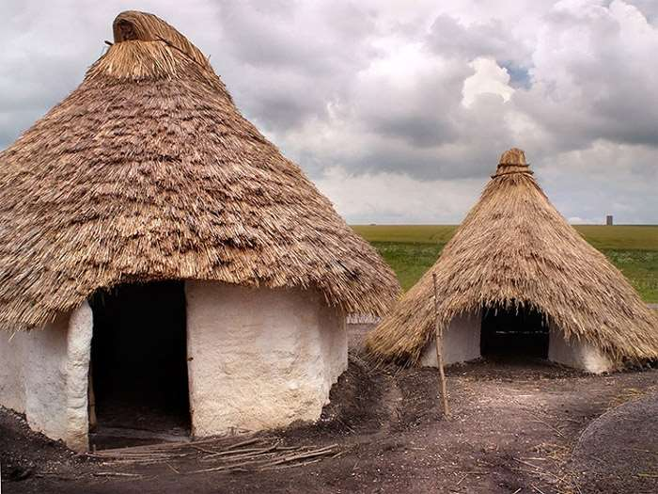
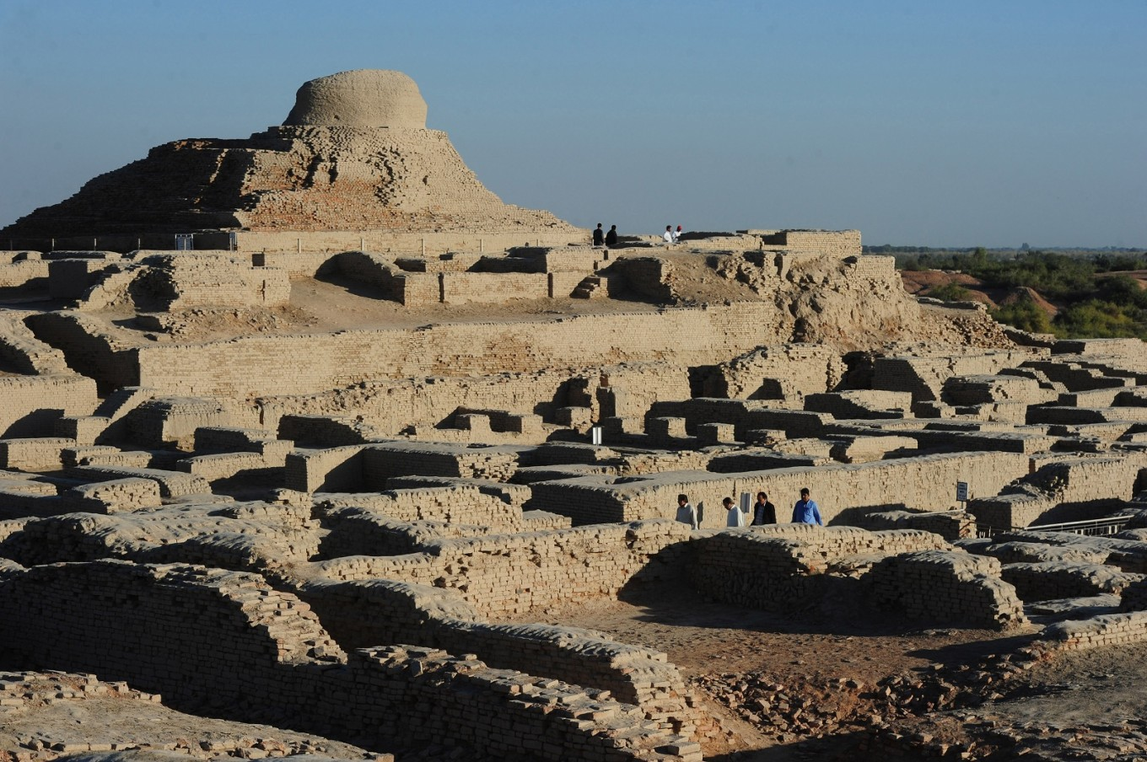
Lets talk: Houses
Houses have evolved.
Stone Age people probably lived in round huts with wooden posts and thatched roofs – one room
Mudbrick houses have been found in Anatolia in the Middle east dated about 9500 years ago
Two storey houses in Mohenjo Daro, Pakistan dated 5000 years ago were built from sun dried mud bricks and boasted courtyards, doors and windows

Slide 8
Lets talk: Houses
What do sort of things do modern houses have?
Energy efficient equipment
Solar panels
High energy efficient glass/windows/doors
Flexible living space
Best use of plot of land
Electric car charging facility
Recycled materials
Low carbon design
Cycle racks

Slide 9
Why am I here today?
To help make you think about a career in construction by getting you to work in a small group, acting a construction company to design and build a house.
But this is no ordinary house and just like real-life, there will be an element of competition between you.
This is a house that YOU as a TEAM will design a house for the future, calculating the cost (financially and its carbon footprint) as well as attempt to build.
This is a lot of work in the time available.

Slide 10
CONSTRUCT:
A HOUSE

